Slide 1
FERPA is . .
Protection for the privacy of student educational records

Slide 2
To whom does FERPA apply?
To all educational agencies or institutions which receive funds under any program administered by the Secretary of Education

Slide 3
Why is FERPA important?
If you access individual student records, under FERPA you are legally and ethically obligated to safeguard the confidentiality of these records and the information they contain.

Slide 4



THE PAST
THE PRESENT

Slide 5
True or False ?
Schools and districts are in jeopardy of court action and monetary damages if they make an unauthorized disclosure under FERPA.

Slide 6
FERPA Myth
False
There is no right to sue for a FERPA violation.
2002 U.S. Supreme Court case Gonzaga v. DOE
Parents and others may not sue a school or district for alleged violations of FERPA

Slide 7
FERPA Remedy
Loss of federal funds is the sole remedy.
In 34 years, no federal funds have been withheld
Allows voluntary compliance if violation occurs

Slide 8
Who is protected by FERPA?
Parents
Right to access and amend their children’s education records
Some control over the disclosure of information in their children’s educational records.

Slide 9
Who is Protected by FERPA?
Students
When a student reaches the age of 18 or attends a post secondary institution at any age
-then-
Considered an “eligible student” all rights held by parent transfer to student.

Slide 10
Who is a “Parent?”
Under FERPA a “parent” is a natural or adoptive parent, a legal guardian or an individual acting as a parent in the absence of the parent or guardian.
34 CFR §99.3

Slide 11
FERPA Basic Propositions
FERPA prohibits schools and school districts from disclosing students’ educational records without written parental consent, unless the disclosure is authorized in the law.

Slide 12
What is personally identifiable information?
Student name,
Parent’s name
Addresses
Personal identifiers – SSN, GTID
Personal characteristics that would make the student’s identity easily traceable
Other information that would make the student’s identity easily traceable.

Slide 13
Authorized Disclosures
(1) To “school officials, including teachers, within the” school district or school whom the school district or school “has determined to have legitimate educational interests.”
34 CFR §99.31

Slide 14
What is a “record”?
“Record” means any information recorded in any way, including, but not limited to, hand writing, print, computer media, video or audio tape, film, microfilm, and microfiche.
20 USC §12329
34 CFR §99.3

Slide 15
What is an “education record”?
A record that is:
directly related to a student,
maintained by the school district or school or by a party acting for the school district or school

Slide 16
Are personal notes “education records?”
Here is the 3 part test:
Kept in sole possession of the maker;
Not accessible or revealed to any other person except as a temporary substitute; and
Used only as a memory aid

Slide 17

Work
Private Life
THE PAST
FACEBOOK®
Twitter®
THE PRESENT
BLOGS

Slide 18
What is Directory Information?
Information contained in an education record of a student that would not generally be considered harmful or an invasion of privacy if disclosed
34 CFR §99.3

Slide 19
Why is Directory Information Important?
Because directory information is publicly available to:
  Media,
  Parents,
  Marketing Organizations, and
  Others upon request

Slide 20
Good News
Each School District or School in some instances has discretion to determine what it will consider “directory information” for its students

Slide 21
Samples of Directory Information
Student name, address, telephone number, email address
Photograph
Birthday
Place of birth
Major field of study
Grade level
Enrollment status
Dates of attendance

Slide 22
More Samples
Sports participation
Weight and height of member of sport teams
Honors and awards
Other information . . .

Slide 23
Photographs
Yearbooks
Team Pictures in programs for sporting events
Video film from bus or hallway cameras

Slide 24
Surveillance Cameras
Use is not directly addressed by FERPA
Is security video tape an “education record?”

Slide 25
Surveillance Cameras. . .con’t.
It depends on…
  Who controls the security cameras and the related video tape?
  If the school’s law enforcement unit, then not an education record
  -BUT-
  If used in a student disciplinary hearing, the video become an education records for those students who have disciplinary charges

Slide 26
Surveillance Cameras. . .con’t
BEST PRACTICE
Have a written policy on use, maintenance and access to these records.

Slide 27
Data Requests
Open Records requests are common
  Is the information directory?
  Can you release the information in aggregate?
  Can you “de-identify” the information?

Slide 28
De-identified Information
Data from education records may be used for research by attaching a code to each record that permits matching information provided:
  Code’s creation process is not revealed
  Code not used for any other purpose
  Code not based on SSN or other personal information

Slide 29
De-identified Information
Data are de-identified when a reasonable determination is made that a student’s data is not personally identifiable-by single or multiple releases, taking into account other reasonably available information.

Slide 30
Public Notice
Policy on Directory Information
Parents may “opt out” in part or totally
Notice by local newspaper, school website, school handbook
  Deadline to “opt out”
Model Notice available

Slide 31
Annual Notice of FERPA Rights
To parents and “eligible students” of their rights under FERPA
Notice where likely to be seen
Provide assistance to inform those who are disabled or whose primary language is not English

Slide 32
Annual Notice
Right to inspect and view their child’s record
Seek to amend record if it is believed inaccurate, misleading
Agree or not to disclosure of personally identifiable information in a student’s education records
Procedures to exercise rights
Model notice available

Slide 33
Authorized Disclosures
Legitimate educational interest
  Schools and school districts must use “reasonable methods” to ensure access on to those with
    Physical
    Technological
    Administrative policy

Slide 34
Authorized Disclosure
Court Order or Subpoena
  Yes, but reasonable effort to notice parent before you release records
  -Unless-
  Order or subpoena required non-disclosure to parents

Slide 35
Authorized Disclosures
Student Transfers or Enrolls
  Send records to receiving school upon request by school, college, parent or student

Slide 36
Authorized Disclosures
Transfer of Disciplinary Records
  FERPA allows transfer of discipline records when a student seeks to enroll or enrolls in another school
  Transfer includes disciplinary records
  NCLB requires such transfer when student has been suspended or expelled.

Slide 37
Authorized Disclosures
Audit or Evaluation of Education Program
  Comptroller General of the U.S.
  U.S. Attorney General
  Secretary of Education
  State and local educational agencies and authorities
Basis of GaDOE’s student information system

Slide 38
Authorized Disclosures
Appropriate parties in connection with financial aid eligibility
Accrediting organization

Slide 39
Authorized Disclosures
Organization conducting certain studies
  Study for, or on behalf of, a school or school district
  Study is for:
    Developing, validating or administering predictive test
    Administering financial aid
    Improving instruction

Slide 40
Authorized Disclosures
Studies. . .con’t
Numerous restrictions on such studies
    No personal identification of parents or students in study’s written report
    Access information is controlled
    Information is destroyed
    No re-disclosure

Slide 41
Health and Safety Emergency
Case-by-case basis
Specific situation presents imminent danger or threat to students or other members of community
-or-
Immediate need for information to avert or diffuse serious threats to safety or health of student or others.

Slide 42
Health and Safety Emergency
Narrowly tailored release
Time-limited
Not authorization for blanket release

Slide 43
Re-Disclosure
A school district or school may disclose information from an education record only on condition that the receiving party will not re-disclose with prior consent of parent or eligible student or written FERPA exception.

Slide 44
FERPA Enforcement
Family Policy Compliance Office (FPCO) is authorized to investigate, process and review FERPA complaints
Parents or “eligible student” may file complaint with U.S. D.O.E., FPCO
Timely – 180 days

Slide 45
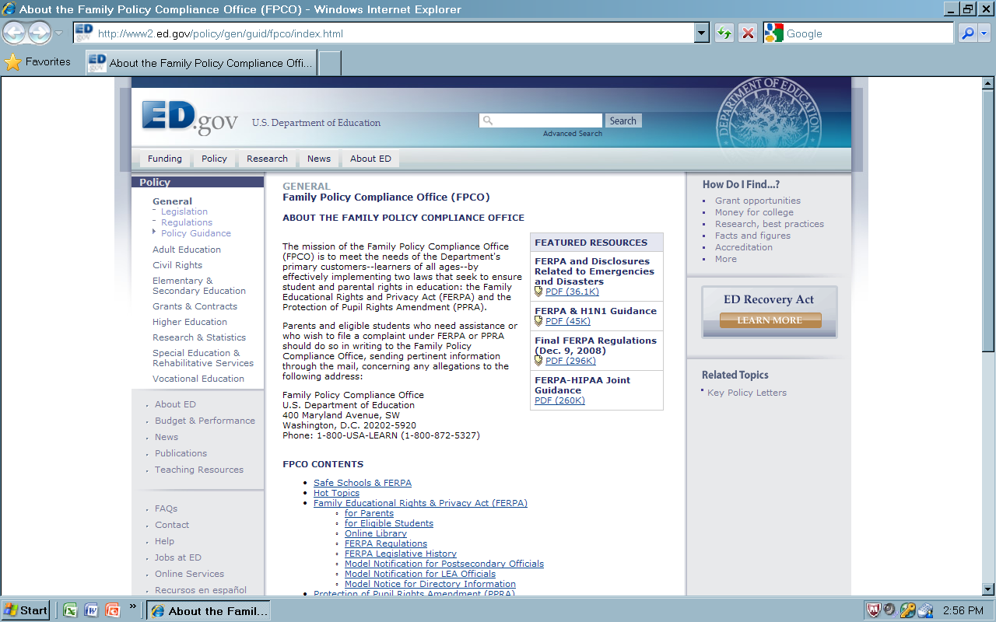

Slide 46
Resources &
Acknowledgment of Credit
Family Policy Compliance Office (FPCO) U.S. Department of Education, 400 Maryland Ave., SW, Washington, DC 20202-5920, 202-260-3887 (P), 202-260-9001 (Fax), www.ed.gov/offices/OII/FPCO
Forum Guide to The Privacy of Student Information, A Resource For Schools, National Forum of Education Statistics
FERPA Code of Federal Regulations (Title 34, Part99) CFR main page, http://www.gpaacee.gov/cfr/index.html
Informational Technical Assistance, FERPA@ed.gov

Slide 47
Resources & Acknowledgments. . .con’t.
Model Notification of Rights under FERPS for Elementary and Secondary Schools, http://www2.ed.gov/policy/gen/guid/fpco/ferpa/lea-officials.html
National Forum on Education Statistics, http://nces.ed.gov/forum/ferpa_links.asp
The Appropriate and Effective Use of Security Technologies in U.S. Schools-A Guide for Schools and Law Enforcement Agencies, http://www.ncjrs.gov/school/home.html
USDOE/ FPCO - Brochure: Balancing Student Privacy and School Safety: A Guide to FERPA for Elementary and Secondary Schools:, http://www2.ed.gov/policy/gen/guid/fpco/brochures/elsec.pdf

